Slide 1
Introduction to JDBC

Slide 2

Assisted Practice
Loading the Driver

Slide 3

JDBC Interfaces
JDBC Driver Manager JDBC Driver
What's in This Module
JDBC URL
Initial connection to database

Slide 4

JDBC Interfaces
Driver
Connection Statement
PreparedStatement CallableStatement
ResultSet

Slide 5
◀ See how we get a connection in a moment
// Get Connection (conn) from somewhere
PreparedStatement ps =
conn.prepareStatement("SELECT ...");
◀ Connection lets us get a PreparedStatement
ResultSet rs = ps.executeQuery();
◀ Execute a query and get a ResultSet
while(rs.next()) {...}
◀ Use the ResultSet
All of this is coded against the interfaces, not
against the implementations

Slide 6
String url = "..."
Connection conn = DriverManager.getConnection(url);
Getting the Connection
To get a connection need to use the DriverManager
The URL identifies the database to connect to and is database specific

Slide 7
Output
com.microsoft.sqlserver.jdbc.SQLServerConnection
Notice that it prints the driver specific class name

Slide 8
JDBC Driver
The Driver Manager loads the driver
Driver provides implementations of the JDBC interfaces
These classes know how to talk to this specific database
JDBC Classes

Slide 9
Loading the Driver
DriverManager.getConnection("jdbc:sqlserver://localhost:1434;databaseName=loboticket; integratedSecurity=true;)

Slide 10
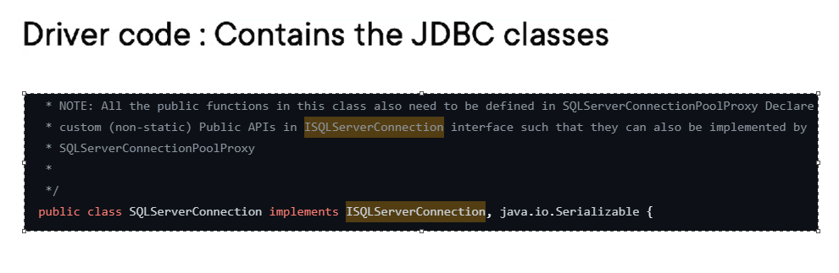
Loading the Driver
DriverManager.getConnection("jdbc:sqlserver://localhost:1434;databaseName=loboticket; integratedSecurity=true;)

Slide 11
Implementation Classes
JDBC Interfaces
JDBC Implementations
Driver
DriverImpl
Connection
ConnectionImpl
Statement
StatementImpl
PreparedStatement
PreparedStatementImpl
CallableStatement
CallableStatementImpl
ResultSet
ResultSetImpl

Slide 12
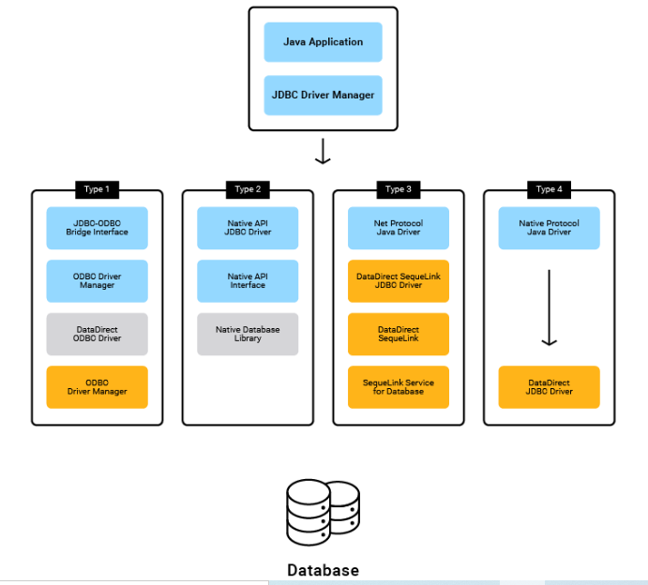
Connections and it's types

Slide 13
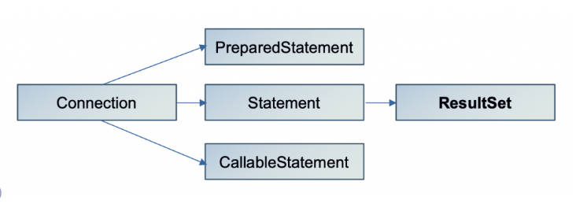
Java ResultSet Hierarchy

Slide 14
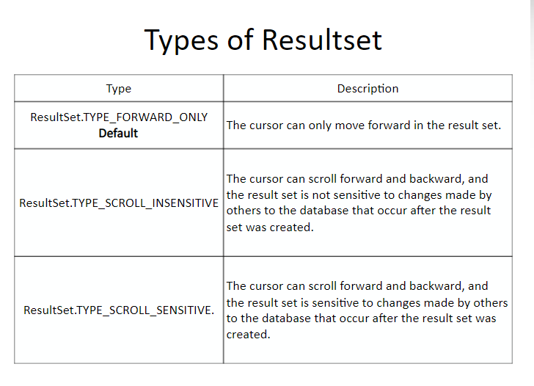

Slide 15
Summary
Code against the 5 specific interfaces
Use DriverManager to load the driver
The loaded driver code has classes that implement the interfaces

Slide 16
Course Demonstrations
Setup
All code is in Eclipse

Slide 17
A 'Ticket' database
Has 'Gigs', 'Acts' and 'Venues'
These are related (see module 2)
Also has stored procedures (see module 7)
The Database

Slide 18
Up Next:
Connection to a Database

